Slide 1
Mobinil Business Configuration
EMM and OLM Troubleshooting

Slide 2
Scope
EMM troubleshooting guidelines
OLM troubleshooting guidelines

Slide 3
EMM

Slide 4
System specifications
EMM File and Event is used to filter and format CDRs received from Mobinil’s Charging System nodes like AIR, CCN, and SDP before sending them to CRS and CADE
Testbed system is at version 7.0
Live system is at version 5.0

Slide 5
Full filesystem
CDR traffic on EMM could be down for a multitude of reasons like a full filesystem for example
From the CLI, running the following command will display all the filesystems and their utilization
# df -kh

Slide 6
Full filesystem (cont’d)
Sample output
# df -kh
Filesystem size used avail capacity Mounted on
/dev/vx/dsk/bootdg/rootvol
48G 43G 3.9G 92% /
/platform/sun4u-us3/lib/libc_psr/libc_psr_hwcap1.so.1
48G 43G 3.9G 92% /platform/sun4u-us3/lib/libc_psr.so.1
/platform/sun4u-us3/lib/sparcv9/libc_psr/libc_psr_hwcap1.so.1
48G 43G 3.9G 92% /platform/sun4u-us3/lib/sparcv9/libc_psr.so.1
fd 0K 0K 0K 0% /dev/fd
swap 15G 79M 15G 1% /tmp
/dev/vx/dsk/lic1dg/vol01
956M 18M 879M 2% /var/opt/sentinel
/dev/vx/dsk/bgw3dg/vol01
50G 661M 46G 2% /var/opt/BGw/ServerGroup1
/dev/vx/dsk/ora1dg/vol01
50G 3.3G 44G 8% /var/opt/mediation/ora
/dev/vx/dsk/fmm1dg/vol01
40G 3.4G 34G 10% /var/opt/mediation/fmmdb
/dev/vx/dsk/bgw2dg/vol01
25G 8.4G 16G 35% /var/opt/BGw/Server2
/dev/vx/dsk/bgw1dg/vol01
25G 10G 14G 43% /var/opt/BGw/Server1

Slide 7
Full filesystem (cont’d)
If a filesystem is full (capacity is 100%), try to remove unneeded files from its mount directory and subdirectories
If vital filesystems like root are full, then the logical servers will automatically shutdown. After cleaning-up the saturated filesystem, start the offline logical servers from CLI. Below is an example for starting logical server Server1:
# BGwControl start Server1
From the GUI, start the configurations

Slide 8
No active configuration
Due to a failed logical server restart or configuration activation, it might happen that a logical server displays no active configuration
When you try to activate a configuration on this logical server you get an error message saying that you should first stop and drain the active configuration
From CLI, kill the logical server ServerX
# BGwControl kill ServerX

Slide 9
No active configuration (cont’d)
Go to directory /var/opt/BGw/ServerGroup1/Server1/CXC<package_version>/storage<X>/config/applications which corresponds to logical server ServerX
Rename file defaultApplication which contains the name of the latest activated configuration on ServerX
# mv defaultApplication defaultApplication.bkp
Start ServerX
# BGwControl start ServerX

Slide 10
No active configuration (cont’d)
In the GUI, activate the configuration on ServerX
Start the configuration

Slide 11

CDR Loss
CDRs could be lost in the EMM configuration due to the business logic DUP code written in filters and formatters
Consider the sample case of the Anonymous Recharge flow in the AIR DRs configuration

Slide 12
CDR Loss (cont’d)
Below is the DUP code in filter AnonymousRecharge
CONST INTEGER main(theSource CONST AIR22ber.DetailOutputRecord)
{
if( isDefined (theSource.refillRecordV2_0.originNodeType) AND theSource.refillRecordV2_0.originNodeType IN ["WebCC", "WCC"]
AND isDefined (theSource.refillRecordV2_0.transactionType) AND theSource.refillRecordV2_0.transactionType == "AnnonymousRecharge"
AND isDefined (theSource.refillRecordV2_0.transactionCode) AND theSource.refillRecordV2_0.transactionCode == "AnnonymousRechargeWebCC")
{
return 1;
}
return 0;
}

Slide 13
CDR Loss (cont’d)
This filter checks the values of 3 fields in the refillRecordV2_0 DR: originNodeType, transactionType and transactionCode
originNodeType should have either values "WebCC“ or "WCC“
transactionType should be "AnnonymousRecharge“
transactionCode should be "AnnonymousRechargeWebCC"

Slide 14
CDR Loss (cont’d)
In case all these 3 conditions are not satisfied, the DR will be discarded and will not be send to CADE so that it can be processed by the Anonymous Recharge adaptation
To check the AIR DRs in readable structured ASCII, go to directory /home/bgw/Decoder/out/air/<yyyymmdd>/
If you cannot find in this directory the AIR DR you are looking for, then it hasn’t been received by EMM or EMM wasn’t able to decode it successfully

Slide 15
CDR Loss (cont’d)
The following DR satisfies the Anonymous Recharge filtering conditions and will be sent to CADE
AIR22ber.DetailOutputRecord.refillRecordV2_0
{
originNodeType : "WebCC"
originHostName : "wcctest"
originTransactionID : "12011030310504017104"
originOperatorID : "ericsson"
originTimeStamp : "20110303105040+0200"
hostName : "tluva01a"
localSequenceNumber : '844944'D
timeStamp : "20110303105040+0200"
serviceClassCurrent : '207'D
transactionType : "AnnonymousRecharge"
transactionCode : "AnnonymousRechargeWebCC"
transactionAmount : "25.000000"
transactionCurrency : "EGP"
voucherSerialNumber : "2000000000000604"
voucherGroup : "N025"
accountNumber : "120029212"
accountCurrency : "EGP"
rechargeAmountConverted : "25.000000"
rechargeAmountMarket : "25.000000"
subscriberNumber : "120029212"
supervisionDateBefore : "20240212"
supervisionDateAfter : "20240212"
creditClearancePeriodBefore : '41'D
creditClearancePeriodAfter : '31'D
serviceFeeDateBefore : "20240222"
serviceFeeDateAfter : "20240222"
serviceRemovalPeriodBefore : '30'D
serviceRemovalPeriodAfter : '31'D
accountFlagsBefore : "10000000"
accountFlagsAfter : "10000000"
activationDate : "20110223"
welcomeStatus : '0'D
agent : "dishnawy"
accountValueAfter : "42.000000"
accountGroupId : '0'D
activationCode : "1316770432396337"
serviceClassOriginal : '207'D
refillType : 'refill (2)'
selectedOption : '1'D
}

Slide 16
CDR Loss (cont’d)
The following DR does not satisfy the Anonymous Recharge filtering conditions and will therefore be discarded
AIR22ber.DetailOutputRecord.refillRecordV2_0
{
originNodeType : "etopup"
originHostName : "etopup"
originTransactionID : "811030209401100022"
originTimeStamp : "20110302094038+0200"
hostName : "tluva01a"
localSequenceNumber : '844930'D
timeStamp : "20110302103052+0200"
serviceClassCurrent : '100'D
transactionType : "eTopUpRecharge"
transactionCode : "eTopUpRecharge"
transactionAmount : "5.000000"
transactionCurrency : "EGP"
voucherGroup : "T005"
accountNumber : "125299275"
accountCurrency : "EGP"
rechargeAmountConverted : "5.000000"
rechargeAmountMarket : "5.000000"
subscriberNumber : "125299275"
supervisionDateBefore : "20121212"
supervisionDateAfter : "20241108"
creditClearancePeriodBefore : '0'D
creditClearancePeriodAfter : '41'D
serviceFeeDateBefore : "20121212"
serviceFeeDateAfter : "20241118"
serviceRemovalPeriodBefore : '0'D
serviceRemovalPeriodAfter : '30'D
accountFlagsBefore : "10000000"
accountFlagsAfter : "10000000"
activationDate : "20110302"
welcomeStatus : '0'D
accountValueAfter : "20.000000"
accountGroupId : '0'D
rechargeDivAmountDedicated10 : "1.000000"
dedicatedAccount10ValueAfter : "11030209.400000"
serviceClassOriginal : '100'D
refillType : 'refill (2)'
}

Slide 17
OLM

Slide 18
System specifications
OLM at Mobinil is an integral part of the Promotional Provisioning GateWay (PPGW) solution
OLM serves as a protocol converter between SMSC (SMPP protocol) and CADE (XML-RPC protocol) and works bidirectionally
Testbed system is at version 6.1
Live system is at version 6.1

Slide 19
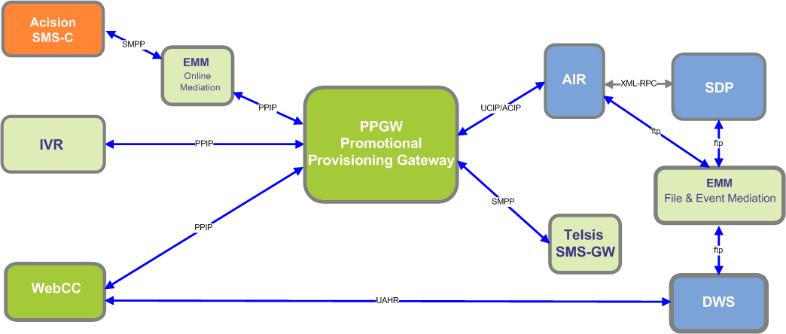
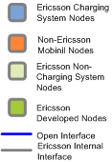
System specifications (cont’d)

Slide 20


Communication failure
Sometimes connection towards F-E and B-E systems could be lost
Open the GUI and click on the Active Alarm List icon
Check the active alarms
Double-click on the alarm that you suspect to be referring to your problem

Slide 21
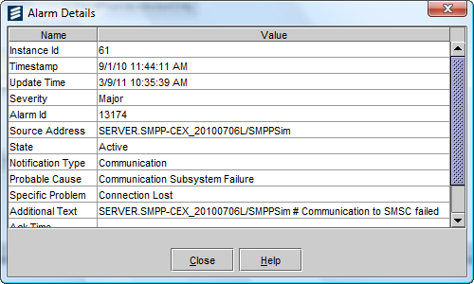
Communication failure (cont’d)
Below is a representative alarm for such a case. The origin of the alarm is a F-E SMPP activity called SMPPSim and the reason for that alarm is a failed communication with SMSC

Slide 22
Communication failure (cont’d)
To resolve this problem, you should first check whether SMSC is down for some reason
If SMSC is not down, then you should make sure that you specified the correct parameters in the properties of the faulty activity
Such parameters could be the SMSC Host, SMSC Port, System ID, and Password. The last 3 parameters should also be enabled on SMSC

Slide 23
Communication failure (cont’d)
More troubleshooting leads could be found in the the following log file:
/mediation/online/var/log/SERVER.Business.0.log
For example, the following error message indicates that the password specified in F-E SMPP activity SMSC2011 is wrong
Time: 2011-02-21 10:20:41.059, Level: SEVERE, Logger: business.SMPP-CEX_20100706L.SMSC2011
- Exception while binding to SMSC: Cannot connect - Invalid password or password lengthie.ncl.msg.ConnectionException: Cannot connect - Invalid password or password length

Slide 24
Snoop Trace
For testing purposes, it is possible to analyze the traffic going through a port used on a F-E or B-E activity. The IP address is that of the system sending the request to OLM (F-E) or the system receiving the request from OLM (B-E)
Use the following command:
# snoop -x0 -ta -o /tmp/<snoop_output_filename>.pcap <IP_address> port <port_number>
Example (SMPP F-E):
# snoop -x0 -ta -o /tmp/4120.pcap 10.56.72.3 port 4120

Slide 25
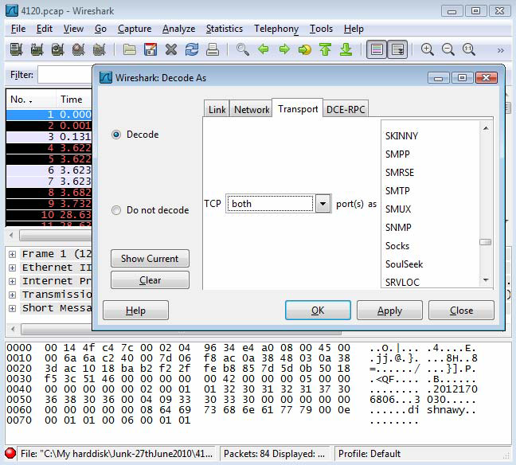
Snoop Trace (cont’d)
Download the snoop file to your machine and open it with Wireshark. Select Analyze -> Decode As ->Transport tab. In TCP select both and on the right select SMPP.

Slide 26
Q&A

Slide 27


